Slide 1
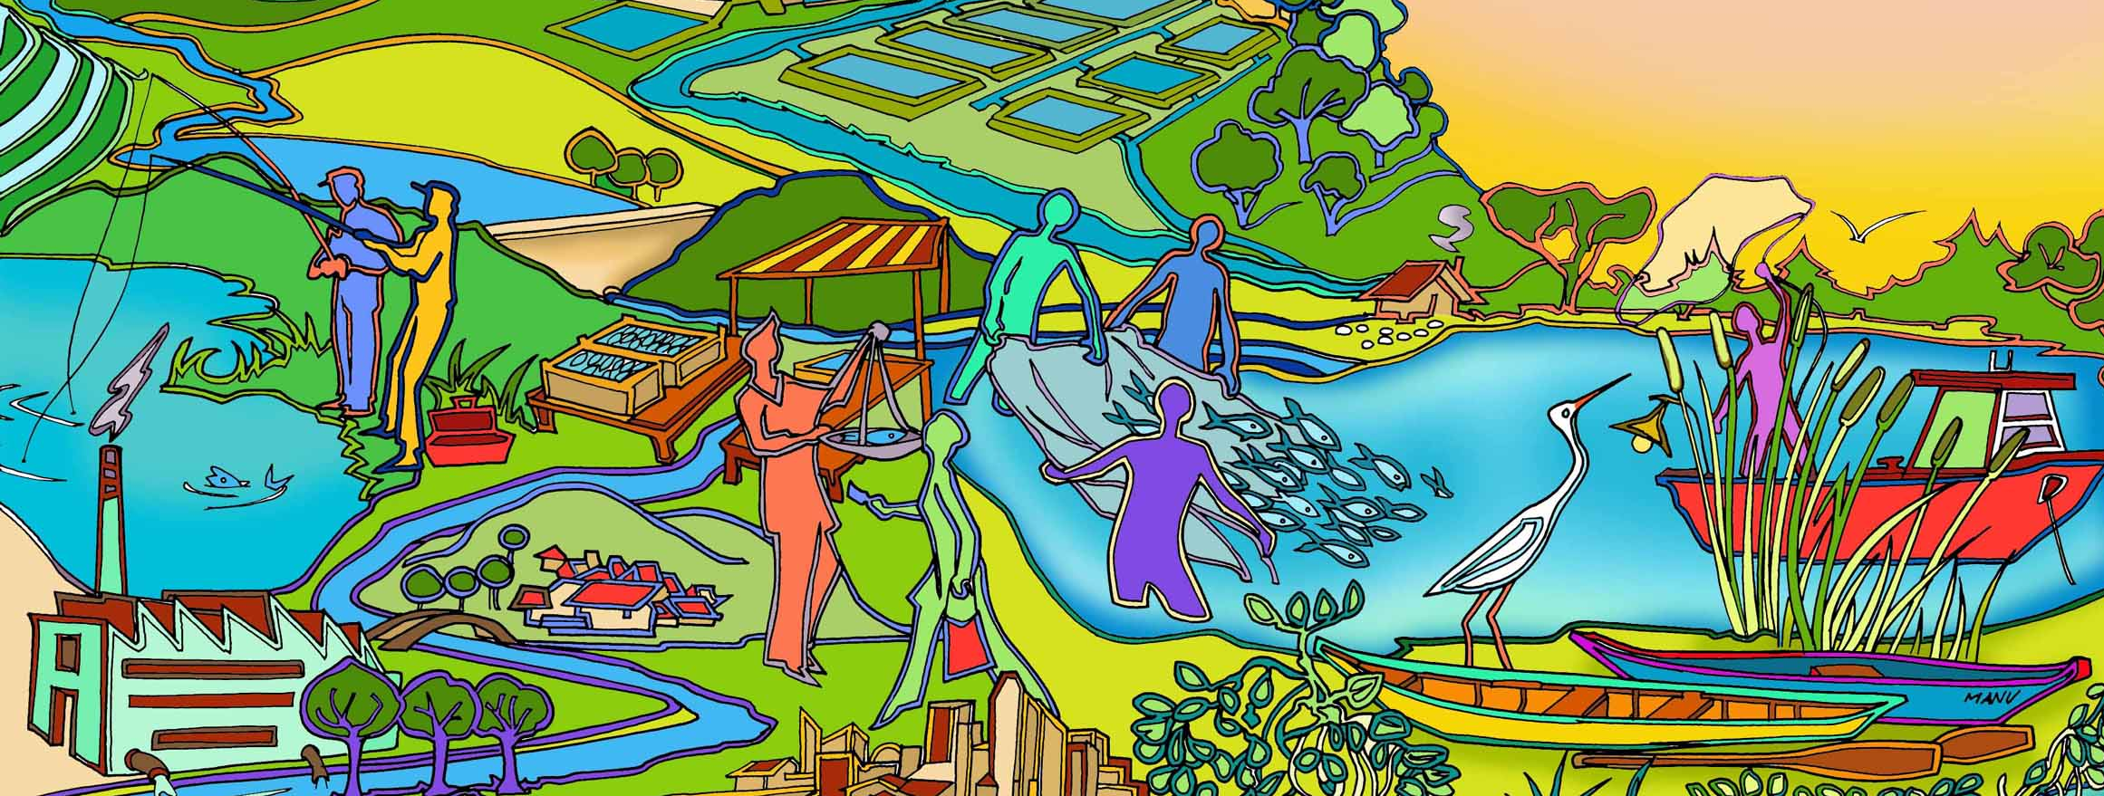
Session 9 EAFm Startup B: Engage stakeholders
Essential EAFm training
Date |Place

Slide 2
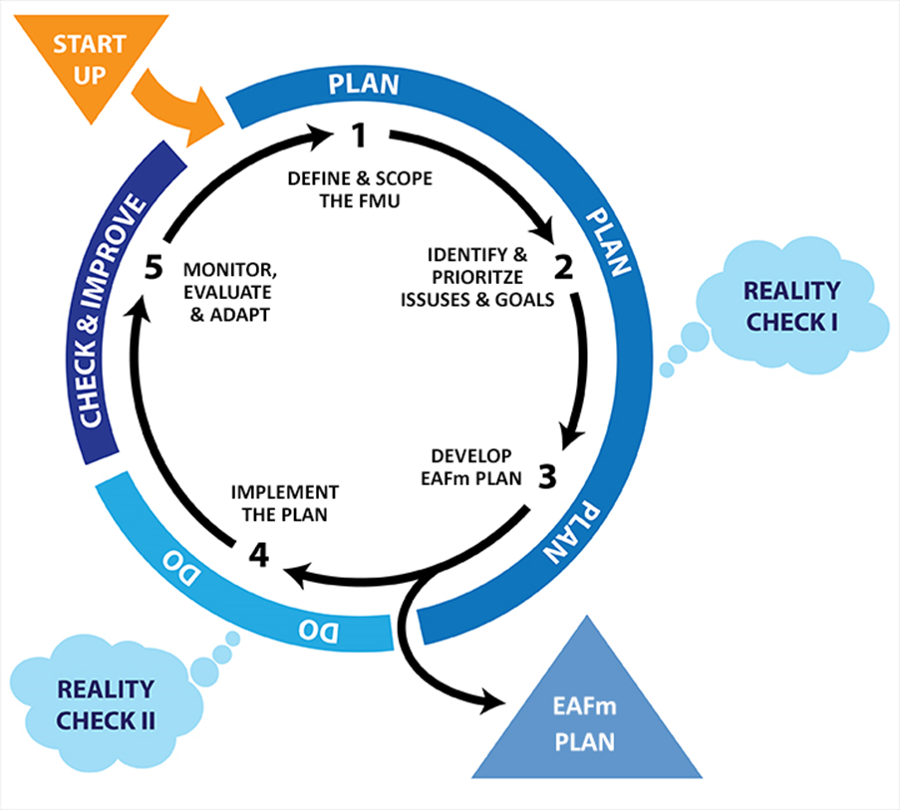
Notes:
We are still in start up – not yet entered the cycle.
Refer to large visual of this on wall (keep up as reference throughout course).

Slide 3
Session objectives
After this session you will be able to:
Apply participatory approaches for stakeholder engagement
Organize and hold stakeholder meetings
Describe the basic concepts of co-management
Notes:
Startup B activities are ONGOING throughout the life of EAFm (unlike Startup A tasks which are one-offs). So what we talk about now, we need to keep on doing throughout EAFm cycle- so we will keep coming back to these and referring to them, i.e..
Work in participatory way with stakeholders
Use meetings/ workshops
Apply co-management principle

Slide 4
Engaging stakeholders
Important to engage stakeholders throughout the EAFm process
Need to have them onboard from the beginning and maintain their interest
EAFm team need people skills (e.g. facilitation, conflict management, etc.)
Notes:
We will practise these people skills later.

Slide 5
Participation
The active participation of people is at the heart of EAFm
So what do we mean by participation?
Notes:
From the beginning we see that PARTICIPATION is key. Remind participants that on day 1 pm we referred to increased participation as one of EAFm principles (# 3).
Refer to participants’ ideas on flipchart from bus stop activity.
Remind participants that Module 9 and People Toolkit contain lots of information and tips on participation- refer to this throughout rest of session.

Slide 6
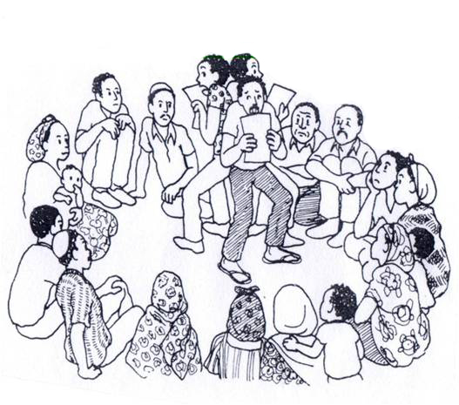
Key principles of participation
Let go of your own ideas and viewpoints
Don’t dominate
Respect of local customs, languages and experience
Promote a process of learning, changing and action
Believe in people and their abilities
Listen and build rapport and trust
Allow all people to be heard
Work with stakeholders
Be flexible
Notes:
These are some of key principles of participation. These include letting go, respecting others, facilitate not control, listening and building rapport.
One common expression is ‘hand over the stick’, referring to culture in which whoever is holding the stick/ shell/ other has the right to speak. The idea is that we need to give space for others to express their concerns/ views (and not impose our own).
Refer to participants’ ideas on flipchart from bus stop activity.

Slide 7
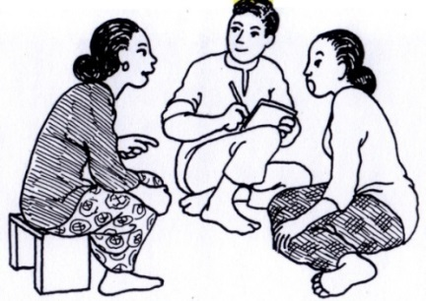
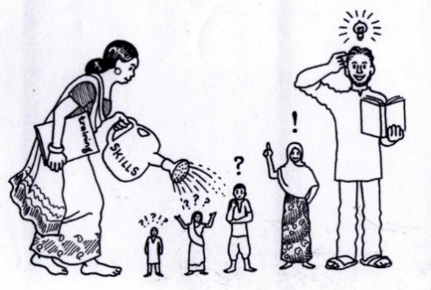
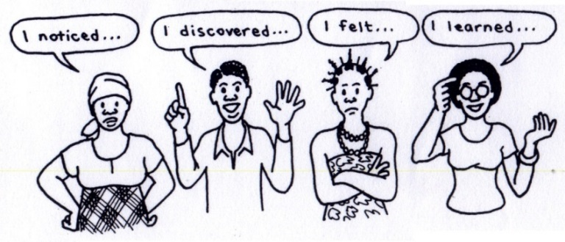
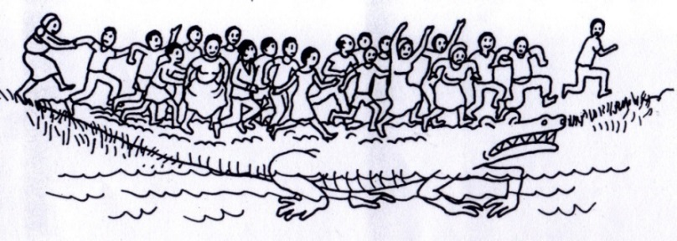
Aim of participatory approaches
Agree on issues and solutions
Identify trade-offs
Empowerment
Awareness raising
Ownership
Group trust
Notes:
The aim of any participatory approach is to (i) strive to let all be heard (ii) empower the less powerful, (iii) gain group cohesion and ownership and (iv) identifying opportunities
Remember to point out about those without a voice (women, ethnic minorities, youth… ) in the face of the more dominant members of community/ department. NB. Trainer must stress importance of consulting/ including those less visible/powerful stakeholders throughout EAFm process.
Why participation is essential:
Empowering process =Encourages independence and self confidence
Catalyst - can be quick and cost effective
Greater sense of ownership amongst stakeholders
Range of stakeholder perspectives included
Promotes action
Literacy is not prescribed
Subjective insights are given value
Builds relationships & partnerships

Slide 8
Facilitating stakeholder input
Meetings
Workshops
Focus group discussions
Interviews
Questionnaires/surveys
Many people involved
Smaller group - technical issues
Small group - specific issues
In-depth views of selected people
Diverse views with large numbers
Notes:
This slide is here to remind participants about participatory nature of EAFm- need stakeholder input right through the process. Range of techniques available, each with their own strengths and weaknesses. This slide summarizes a few of them. More in the People Toolkit.
More detailed background info
Methods here mirror methods outlined in Start Up A and specifically for data collection 1.3 (scoping). Discuss how different methods can be used at different stages of EAFm step 2 (and other). See People Toolkit n. 3-6. You can have initial workshop with many, then FGDs to hone in on certain issues. Or you can have FGDs to brainstorm issues and then have wider collective consultation using surveys.
-Focussed stakeholder discussions are an essential tool for developing an understanding the issues in the fishery and the factors affecting the fishers or other stakeholders that interact with it. In particular, stakeholder discussions can reveal conflicts, economic factors or local knowledge which may greatly influence the sort of objectives and management actions developed under the EAFm plan.
Link to participation and possibly mention history of participatory approaches if you are familiar with them (such as RRA- Rapid Rural Appraisal; PRA= Participatory Rural Appraisal; PLA= Participatory Learning + Action).
All EAFm steps involve stakeholder meetings/ workshops
Invite ALL stakeholders to meeting(s). Note: a representative might be chosen to follow through. Include all people affected by the plan (+ve and –ve effects) . Hold multiple/ grouped meetings. See Module 9, section 3. Meetings is one of the main methods for community organising and co-management.
Challenges: complex linkages across sectors, across boundaries, within a country vertical: (national – local) and horizontal (between different users of natural resources).
Think of less visible stakeholders (women, poor, landless, ethnic groups…). How can you access their views? How can they be included in EAFm planning process?

Slide 9
Activity: In your groups
Group A: draw a very GOOD facilitator!
Group B: draw a very BAD facilitator!
No words or writing allowed!
Notes:
Set up the activity. See explanation in session plan. Ask participants to think from their experience: good facilitation- what are main elements? Badly facilitated workshop/ meeting: what were main reasons? This is to get participants thinking about facilitation. Quick review of main facilitation skills (patience, listening skills, ability to foster trust/ confidence, respect for others, flexibility, empathy… Trainer refers participants to Module 9 and People Toolkit. These have much more detail on facilitation, tips, how to facilitate meetings/ workshops, attitude of facilitator, etc. Can all be referred to for sessions on co- management/ conflict/ all steps that involve meetings).

Slide 10
EAFm involves …
Co-management
Coordination
Consultation
Cooperation
Negotiation
Joint decision-making
Notes:
You will recall that the principles of participation as well as coordination and cooperation were important for EAFm. These are achieved through co-management that will involve negotiation and joint decision making.

Slide 11
Co-management …
Partnership arrangements in which stakeholders share the responsibility and authority for the management of the fishery, with various degrees of power sharing
Notes:
This is one definition of co-management. The phrase with varying degrees of power sharing is explained in the next slide.

Slide 12
Degrees of power sharing
More
Community control
Partnership
Advisory
Cooperative
Consultative
Communicative
Informative
Less
Notes:
Degrees of power sharing can be drawn as a continuum ranging a low base of simply being a mechanism for information sharing right through to full power in community control.
Refer to Participant Handbook Module 9, Figure 9.2: Degree of control and consultation in different forms of fishery management

Slide 13
Key elements of co-management:
Working together – power sharing
Better dialogue and communication
Reducing conflicts
Learning together
Sharing costs and benefits
Sharing successes and failures
Notes:
Key elements
Working together – sharing, especially through empowerment
Better dialogue and communication
Reducing conflicts
Learning together
Sharing costs and benefits
Sharing successes and failures

Slide 14
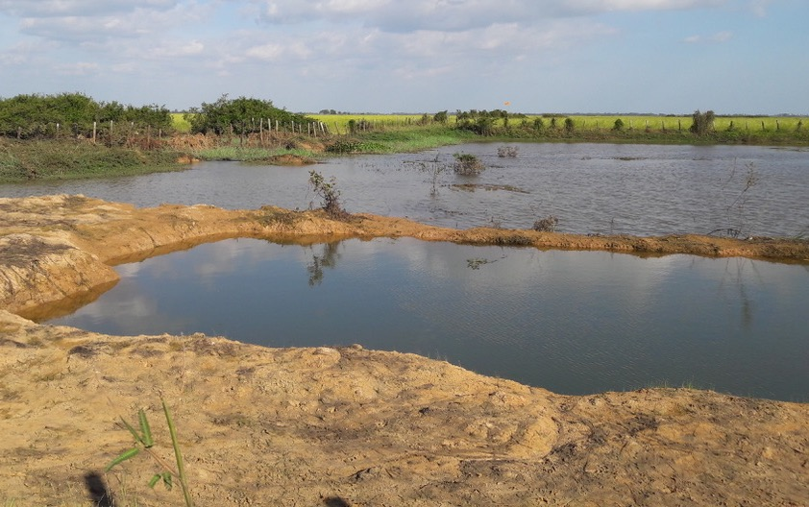
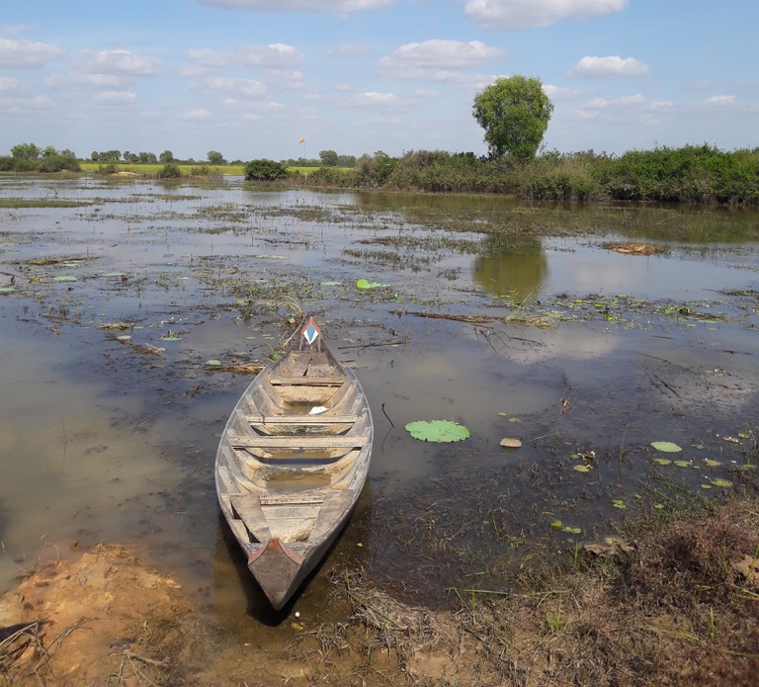
Example: Cambodian Fish Refuges
Increasing populations and open access fisheries in rice fields
Anyone can fish and tend to target water bodies in dry season
Loss of broodstock limited recruitment to fishery
Pilot projects to promote community led refuges
Common rules on fishing, agreement not to fish in refuge areas
Now institutionalized and promoted as a national programme
Fishery Department work with communities
Notes:
Cambodian Fish Refuges: Rice field fisheries are estimated to contribute up to 28% of the wild capture fisheries in Cambodia. Rice field fisheries are seen as a promising sub-sector to increase fish catches and meet the domestic demand for food. Providing safe refuges for fish during dry season helps to stabilize fish populations in rice fields . Under high population pressure and breakdown of community traditions , fishers target dry season refuges. Impacts broodstock and creates conflicts. Establishing a Community Fish Refuge (CFR) is a form of fish conservation/stock enhancement management measure. It is intended to improve the productivity of rice field fisheries. Refuge ponds can be man-made ponds or natural ponds that can hold water throughout the year. The idea behind refuge ponds is to create dry season refuges or sanctuaries for brood fish in seasonally inundated rice fields. Fish refuge ponds are typically not privately owned, as the connecting rice fields become open access when inundated. Fingerlings and/or brood fish may be stocked in these water bodies, sometimes with habitat protection. The management of large water bodies in this collective way requires local organizational arrangements Communities must collectively agree on a combination of regulations needed to manage water bodies and control their fishing activities. The improved fisheries, and stronger community dialogue, provides a basis form more effective management measures. Dry season refuges are often a traditional approach, but one that gets lost as community cohesion starts to break down. The idea Idea to promote started in 1995 and slowly became a pilot programme. By 2005, The “Statement of the Royal Government of Cambodia on the National Fisheries Policy” stipulates CFRs should be developed all around the country where appropriate. The process to mobilize communities and establish the refuges follows an approach similar to a simplified EAFm. http://pubs.iclarm.net/resource_centre/WF_3147.pdf

Slide 15
Preparing stakeholders to actively engage:
Awareness raising
Knowledge empowers people and improves their ability to take part (awareness of environmental, social/governance issues)
Methods can include:
training, focus group discussions, media campaigns, stories and policy briefs
Notes:
A lot of effort needs to be put into preparing stakeholders to engage. This must involve awareness raising, as knowledge empowers people and improves their ability to take part. A range of awareness raising tools are available (see Tool 9).

Slide 16
Preparing stakeholders to actively engage (cont.):
Community mobilization
Stakeholders get organized to arrive at consensus on interests and concerns
Methods can include:
environmental education
building alliances and networks and
human capacity development
organizational planning
Notes:
As well as awareness building, the EAFm Team will need to mobilize different stakeholders in what is known as community mobilization (see Tool 10).

Slide 17
Assess stakeholder interest and commitment
Stakeholders will have different levels of interest in the process
 | Some awareness of problems with fisheries | Concern about these problems | Willingness and ability to take action to solve these problems | Action needed
Stakeholder 1 |  | X
Stakeholder 2 |  |  | X
Stakeholder 3 | X
Notes:
Know your stakeholders, We used a 2x2 matrix earlier in Startup A to identify stakeholder groups. Another tool to asses individual interest within a group is a stakeholder engagement matrix that is explained in Tool 18. Also gets you to focus on actual actions/ways forward to get ‘buy in’ from different stakeholders.
Ask question: How ready are stakeholders to embark and commit to the EAFm process? You can have a simple matrix and agreed criteria and then groups can plot various stakeholders onto this matrix. This builds on stakeholder analysis they did earlier. This would be done by EAFm team.
NB. If this exercise is done ideally with key stakeholder (i.e. after task vii), the chances are result would be slightly different, as there would be representatives of key stakeholders doing the actual analysis. This tool can be used more than once. It is good practice to do same exercise 1 year on and see if stakeholders have moved places (acts as a form of monitoring/ assessment).

Slide 18
Key messages
Undertake a legal review
Stakeholder engagement is initiated in the Startup but continues through the whole EAFm process
EAFm involves developing co-management arrangements, so stakeholders are involved in planning, implementing, as well as evaluating and adapting
Stakeholder engagement requires people skills and there are a number of tools that can be used
Notes:
Self explanatory

Slide 19
Active listening in threes
Two of you discuss examples of co-management that you are familiar with/ have experienced/ know of (think about topics we have just discussed)
The 3rd person observes (can take notes) then feeds back. Rotate so you all get a chance to speak and observe
Practice active listening: ☺ Paraphrasing ☺ Clarifying
☺ Eye contact ☺ Body language
Notes:
See details in Session Plan.
Aim: to practice active listening skills for building rapport (for better communication with stakeholders, for facilitation).
Time: 15 minutes, in threes
Task: Show slide 16 instructions. Quickly brainstorm characteristics of active listening onto flipchart, explain paraphrasing (make a few suggestions from Tool 2 to get participants started). Explain we will now do a quick activity where participants practise this skill.
In groups of 3s, two people discuss co-management experiences, while the 3rd person observes (and can take notes) and then feeds back. Rotate so that they all get a chance to speak and observe.
Trainer draws out key lessons / tips = Importance of using active listening when facilitating.

